Slide 1
Making Kubectl PowerShell Friendly
The PoSh Wolf
https://github.com/theposhwolf/sessions

Slide 2
Who is The PoSh Wolf?
Anthony Howell
From Eugene, OR USA so, according to ChatGPT, I am:
Progressive, outdoorsy, creative, friendly, and open-minded
~3.3 kids, 2 dogs, 1 wife, 1 cat
In IT since 2011
Blogger (https://theposhwolf.com)
Twitter (https://twitter.com/theposhwolf)
Pluralsight author (https://pluralsight.com)
Consulting (https://howell-it.com)
Employed (Cloud Platform Architect)

Slide 3
Overview
What is the problem?
Why not Crescendo or -o json?
Technical solution - Parsing output
Gotchas
Technical solution - Generating PowerShell formats
Reducing reliance on Where-Object (Filtering Left)

Slide 4
The Problem
Kubectl is just stdout

Slide 5
Crescendo or -o json?
Crescendo
Definitely more PowerShell-y (verb-noun)
Not cross-shell compatible
Not a bad tool, just not the right tool for the job
kubectl get pod -o json | ConvertFrom-Json
Too much typing
Too much data, usually

Slide 6


Slide 7
Solution Requirements
Preserve syntax
Preserve output format
Keep it reliable and efficient

Slide 8
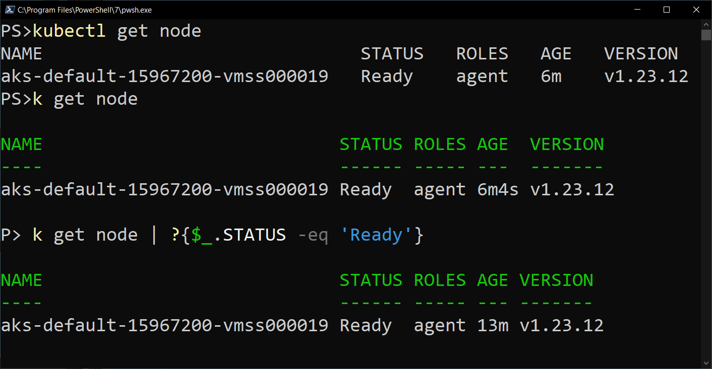
My Solution

Slide 9
Prerequisites
PowerShell 7+
Kubectl

Slide 10
Demo Environment
Windows 10
VS Code (latest version)
PowerShell 7.3.3
specialK
Kubectl

Slide 11
Parsing

Slide 12
Process
Use headers to calculate spacing indexes
Insert semicolons
ConvertFrom-CSV –Delimiter ‘;’
Insert type name (for format)

Slide 13
NAME READY STATUS RESTARTS AGE
database-deployment-194a92db12-b2aat 1/1 Running 0 10d
web-deployment-98ad9380dd-8brg3 1/1 Running 0 2d7h

Slide 14
NAME ;READY ;STATUS ;RESTARTS ;AGE
database-deployment-194a92db12-b2aat ;1/1 ;Running ;0 ;10d
web-deployment-98ad9380dd-8brg3 ;1/1 ;Running ;0 ;2d7h

Slide 15
NAME;READY;STATUS;RESTARTS;AGE
database-deployment-194a92db12-b2aat;1/1;Running;0;10d
web-deployment-98ad9380dd-8brg3;1/1;Running;0;2d7h

Slide 16
Formats

Slide 17
Filtering Left

Slide 18
github.com/theposhwolf/specialk

